Slide 1


A Giant in Crisis:
A Research for the failure of Yonghui’s Business Model

Slide 2
Agenda
01
02
Introduction
Business Model Analysis
03
04
Further Exploration
Summary

Slide 3
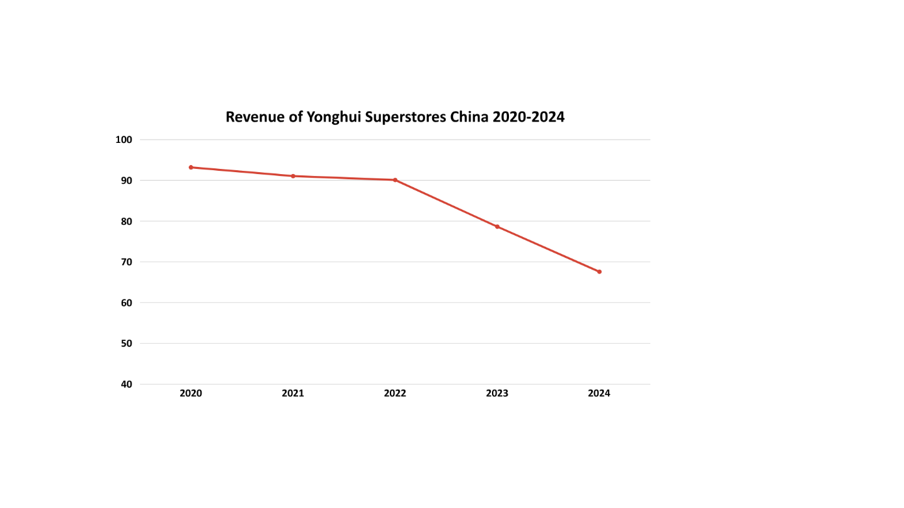
Introduction
1.1 Yonghui Superstores: A Giant in Crisis
The Rise of a Retail Giant
Established & Recognized：
Founded in 2001 in Fuzhou, Fujian.
"National Top 500 Enterprise"
"People's Supermarket, Yonghui for All"
Scale & Expansion
The Winning Formula
Low Prices + Fresh Produce + Wide Assortment
crushed competitors in the 2010s
Went public in 2010 (SHA: 601933)
Over 700 stores across 441 cities
Exceeded 6.13 million square meters
The Alarming Downturn
Introduction
Business Model Analysis
Further Exploration
Summary

Slide 4
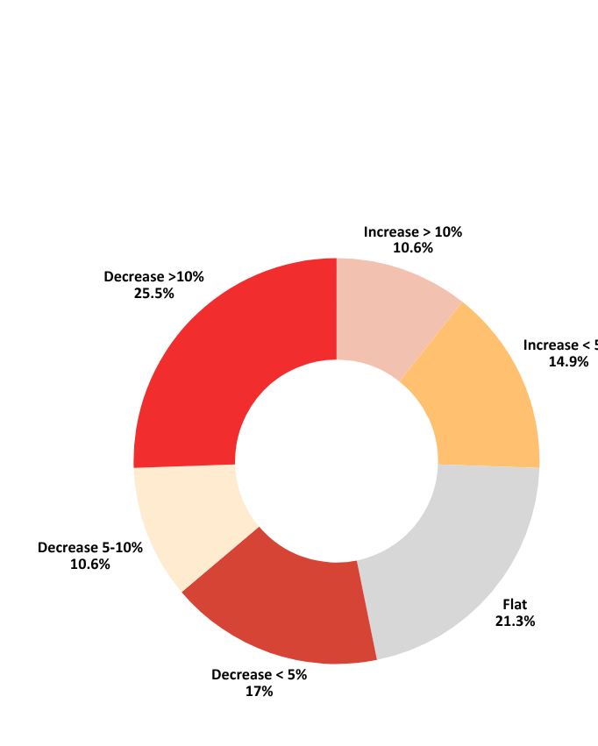
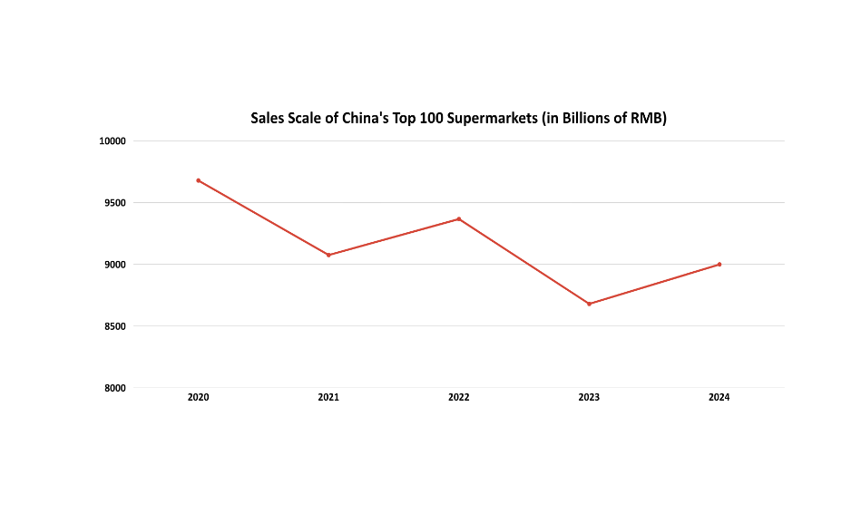
Introduction
1.2 Industry Analysis: Overall Market Shrinkage
Decreased Sales Scale
Decreased profits
Introduction
Business Model Analysis
Further Exploration
Summary

Slide 5






Introduction
1.3 Core Question
Why did Yonghui’s once-unbeatable business model suddenly fail?
The threat of E-commerce, Community Group Buying, and Consumer Trading Down…
Introduction
Business Model Analysis
Further Exploration
Summary

Slide 6
Business Model Analysis
2.1 Revenue Decomposition
Drill down the revenue changes over the past 5 years
Annual Revenue Change Amount
Compare Years | Change in Rev. | Same-Store Effect | Store Count Effect
2020 vs 2019 | 8,322,147,620 | -1,553,766,501 | 9,875,914,121
2021 vs 2020 | -2,137,213,352 | -5,802,861,638 | 3,665,648,286
2022 vs 2021 | -971,074,916 | 1,096,555,608 | -2,067,630,524
2023 vs 2022 | -11,448,647,819 | -8,570,625,515 | -2,878,022,304
2024 vs 2023 | -11,068,347,477 | 6,626,141,128 | -17,694,488,605
Same-Store Effect =
Total Revenue for This Year -
Assumed Revenue
(Reflect the changes in the operational capabilities of existing stores themselves)
Store Count Effect
=
Assumed Revenue
-
Total Revenue of Last Year
(The change in revenue purely brought about by the behavior of opening and closing stores)
Assumed Revenue = Single Store Revenue Last Year × The Number of Stores This Year
Assuming that the sales capacity of each store this year is the same as last year, how much revenue should there be this year just by opening and closing stores
Introduction
Business Model Analysis
Further Exploration
Summary

Slide 7
Business Model Analysis
2.1 Revenue Decomposition
2020-2023:
Revenue growth initially came entirely from new stores, masking falling same-store sales.
From 2021, same-store sales collapse became the main cause of revenue loss — a clear sign of a broken store model.
Closing stores couldn’t offset the widespread deterioration in existing locations.
2024:
The revenue drop was almost entirely due to closing 225 stores, a massive network cut.
Same-store sales turned strongly positive — the remaining smaller network is now selling significantly more per store.
Shift in strategy: accepting a smaller business to focus on a healthier core.
Introduction
Business Model Analysis
Further Exploration
Summary

Slide 8
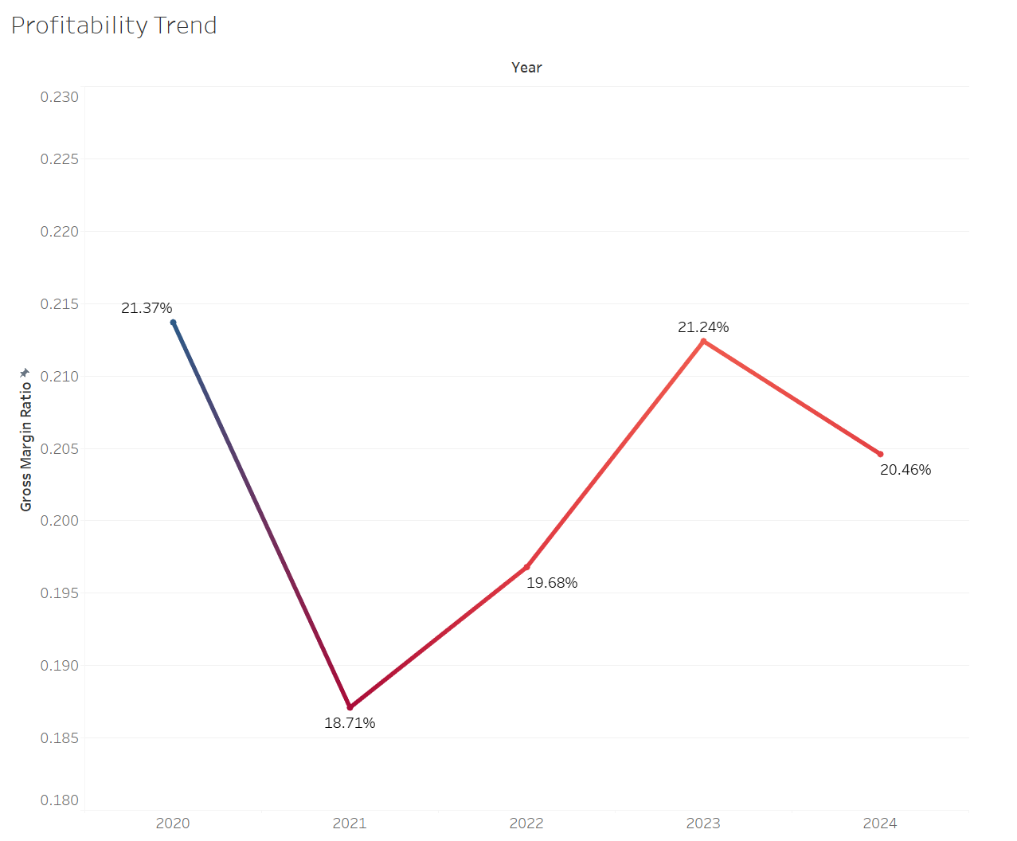
Business Model Analysis
2.2 Profitability Trend
Stable Gross Margin Could Not Prevent a Descent into Loss
Despite a resilient gross margin, the core net profit has been deeply negative since 2021, revealing a fundamental profitability crisis.
Introduction
Business Model Analysis
Further Exploration
Summary

Slide 9
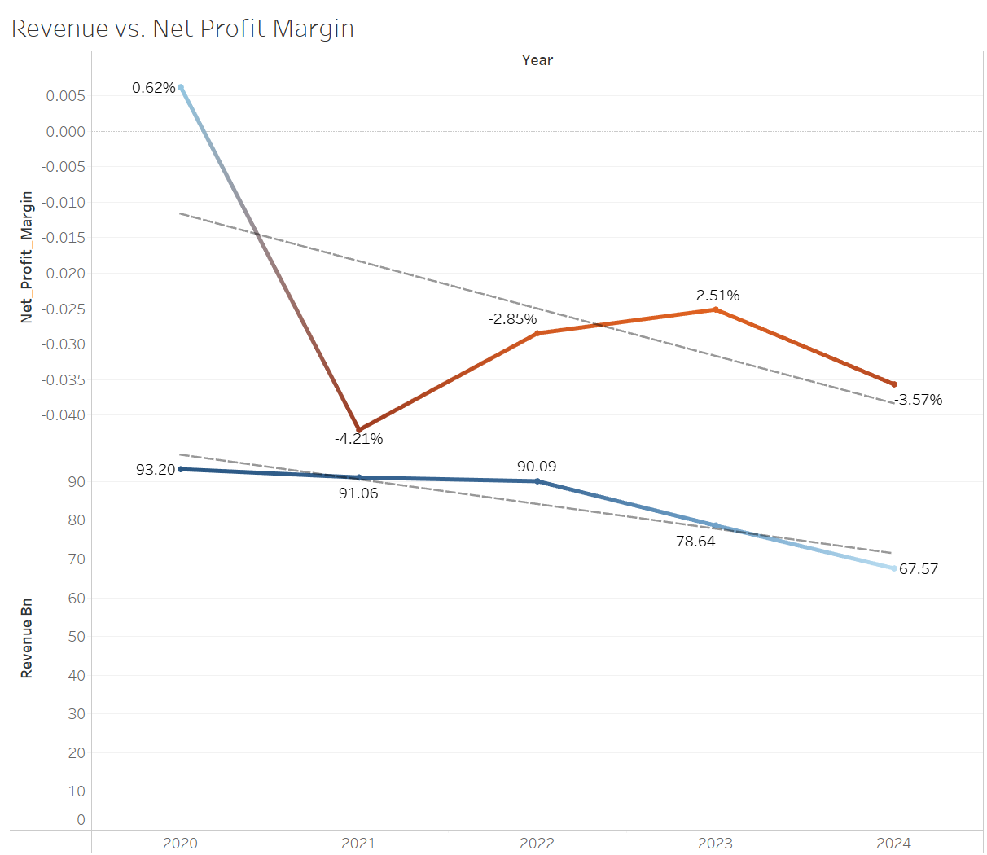
Business Model Analysis
2.2 Revenue vs. Net Profit Margin
The “Scissors Effect”: Falling Revenue Amplifies Losses
As revenue contracted, the profit margin collapsed at a steeper rate, exposing severe fixed cost rigidity and negative operating leverage.
Introduction
Business Model Analysis
Further Exploration
Summary

Slide 10
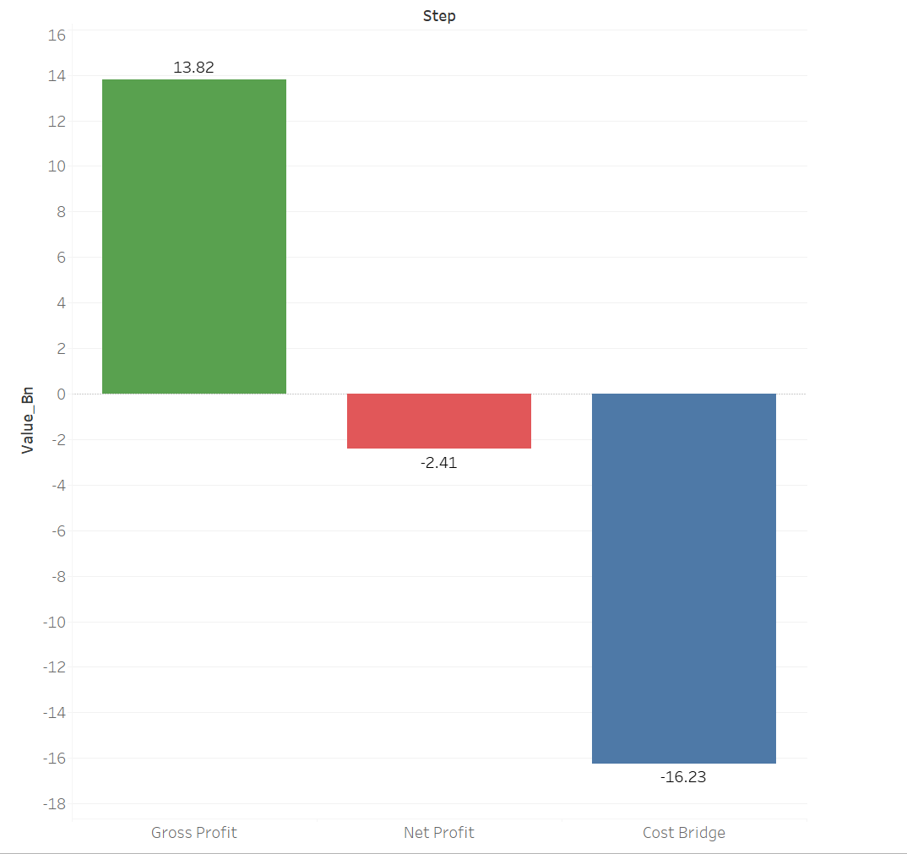
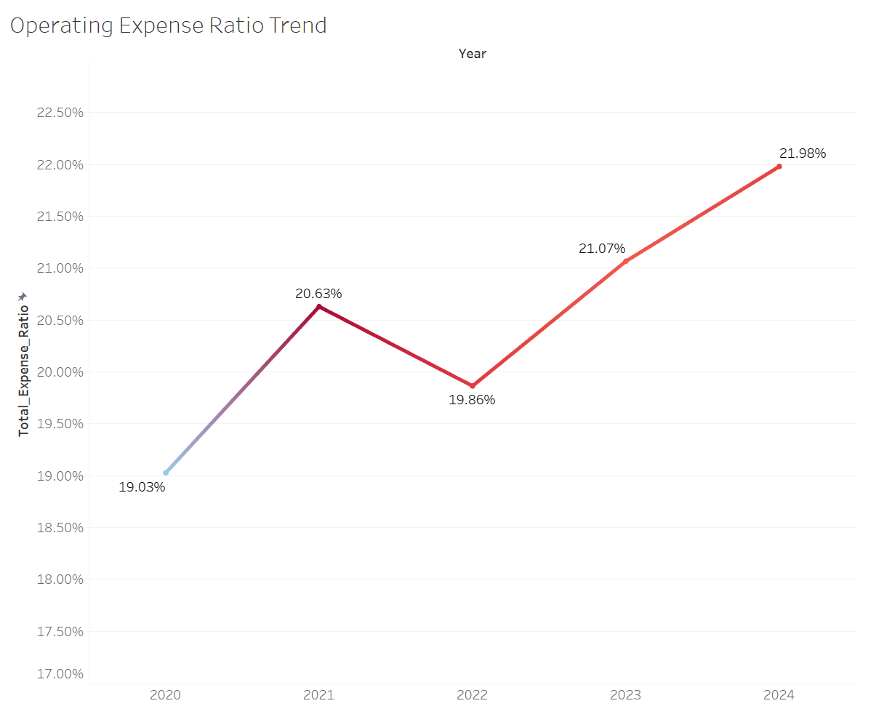
Business Model Analysis
2.2 Profit Structure Breakdown & Operating Expense Ratio Trend
Gross Profit Completely Devoured by Costs (2024)
Operating Costs Consumed an Ever-Larger Share of Revenue
In 2024, operating costs completely devoured the gross profit, leading to a net loss.
The expense-to-revenue ratio has climbed persistently since 2021, proving the cost pressure is intensifying.
Introduction
Business Model Analysis
Further Exploration
Summary

Slide 11
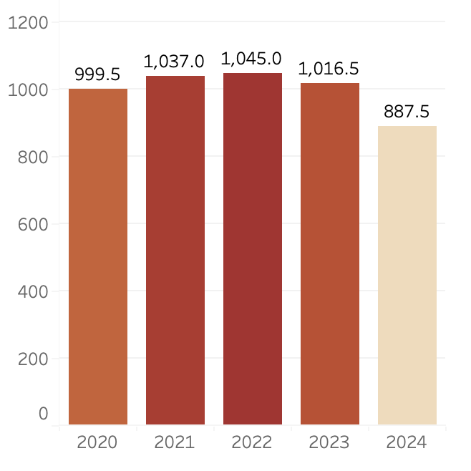
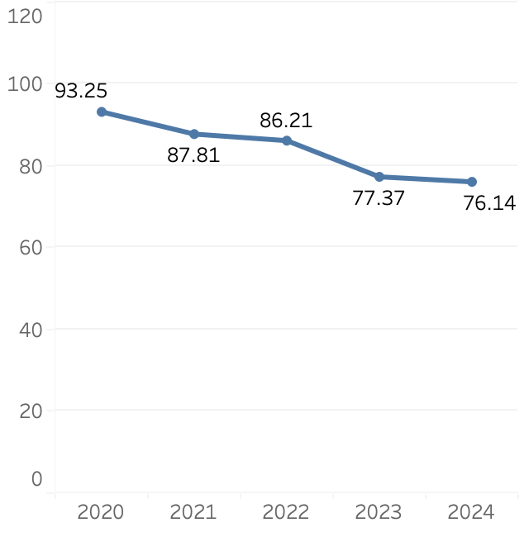
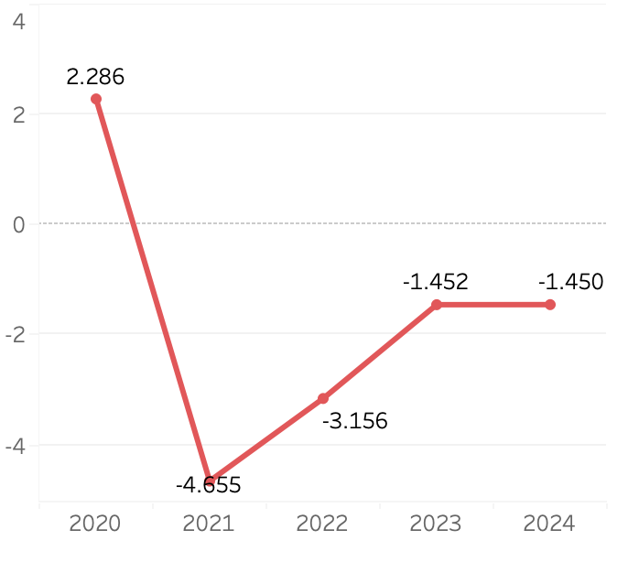
Business Model Analysis
2.3 Store Expansion
Average stores
Revenue per store
Operating profit per store
(Unit: CNY million)
(Unit: CNY million)
Stores expanded until 2022, followed by consolidation.
Turned negative since 2021 & remained below zero.
Declined steadily during the period.
Introduction
Business Model Analysis
Further Exploration
Summary

Slide 12
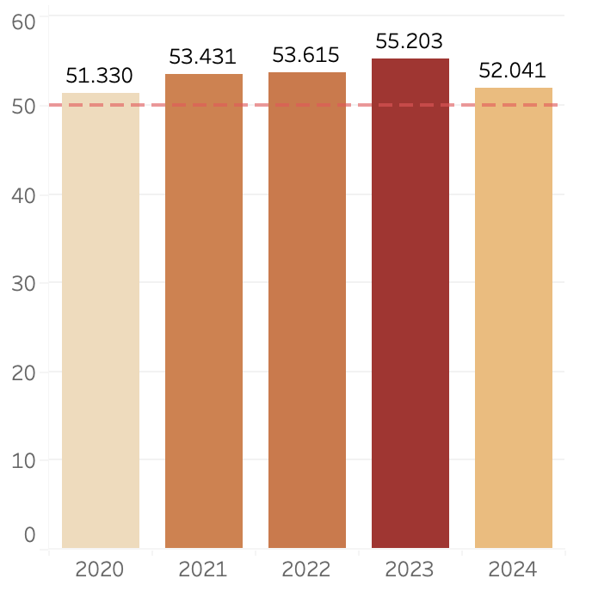
Business Model Analysis
2.3 High Inventory Turnover Days
Inventory turnover days
( Unit: days )
High inventory intensity (>50 days)
→ higher spoilage risk & working-capital lock-up
Fresh-food–dominant model
→ limited flexibility in inventory reduction
Result：Cost pressure persists, constraining margin & profit recovery
Introduction
Business Model Analysis
Further Exploration
Summary

Slide 13
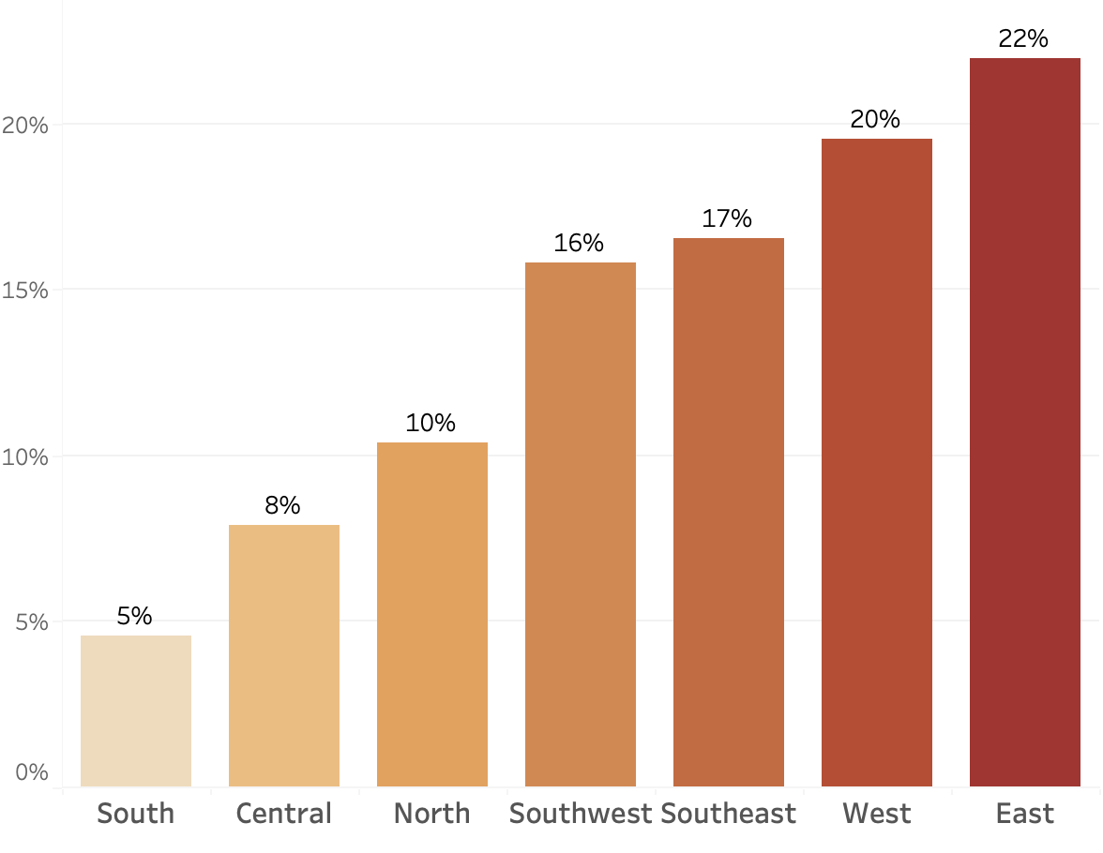
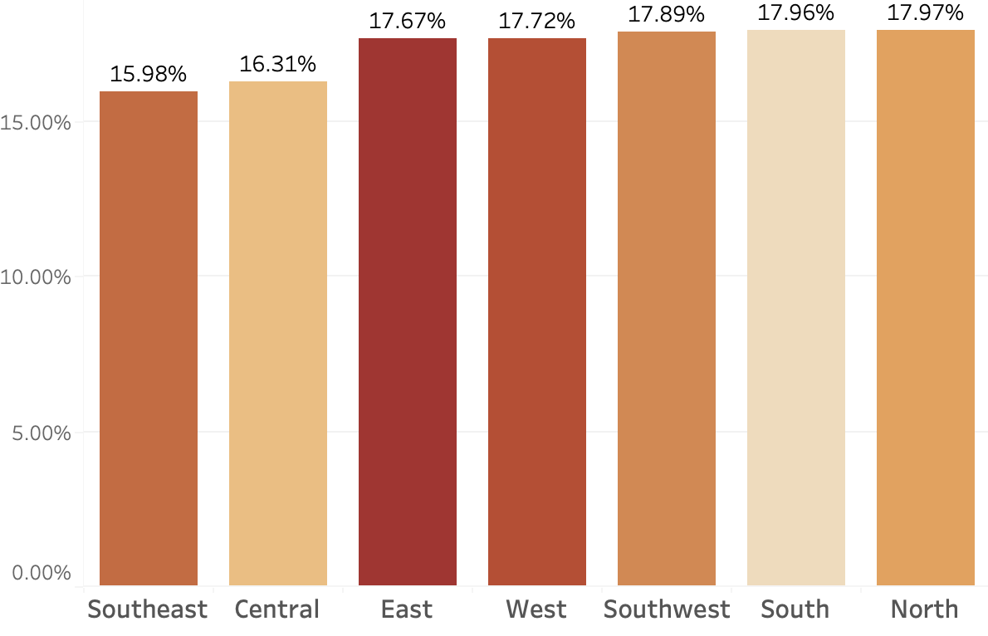
Business Model Analysis
2.3 Regional Revenue Concentration & Margins
Avg. Region Revenue Share
Avg. Region Gross Margin
Revenue is concentrated in a few regions (East & West >40%).
High-revenue regions Do Not generate higher gross margins.
High revenue regions also face high costs.
Introduction
Business Model Analysis
Further Exploration
Summary

Slide 14










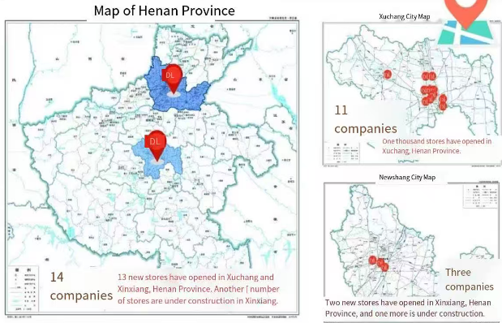
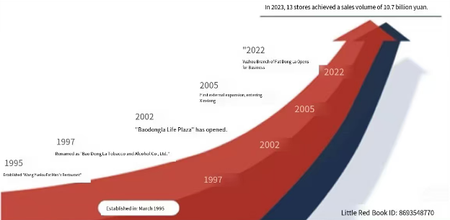



Further Exploration
3.1 Company Overview
Company Basics
Store Presence
11
3
Xinxiang
Xuchang
Financial Performance
 | 2020 | 2021 | 2022 | 2023 | 2024
Sales | 78.5 | 85.2 | 92.3 | 105 | 120
Net Profit | 4.5 | 5.2 | 6.1 | 8.2 | 10.5
Introduction
Business Model Analysis
Further Exploration
Summary

Slide 15


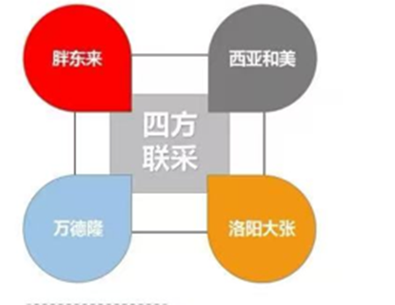




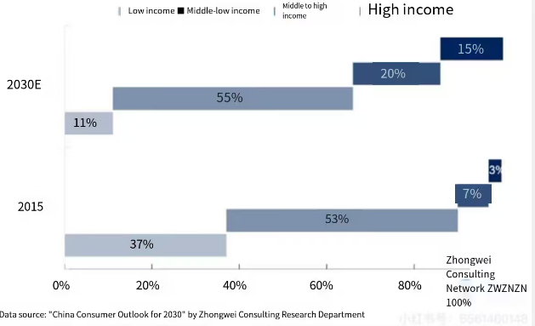
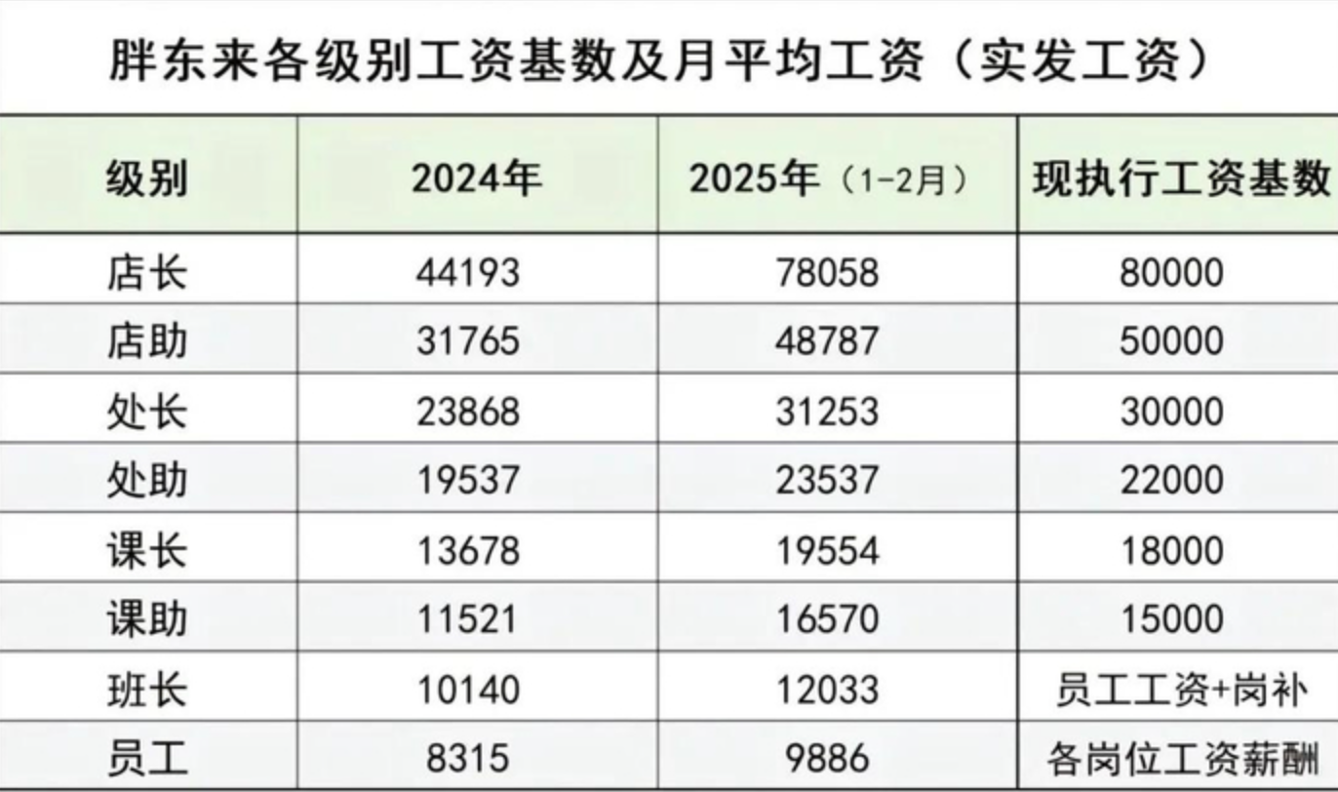
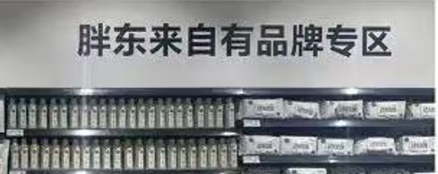
Further Exploration
3.1 Unique Business Strategy
1. Product and Supply Chain
2. Service and brand reputation
3. Organizational and Regional Operation
Supply Chain Localization(80%)
Private Brand Development
Addresses consumer needs for quality and value
Counter-Scale Regional Strategy
Monopoly on Local Markets
Deepen users with offline channels at the core
Avoid Blind Expansion
Employee Empowerment
Holiday days
140 vs 68
turnover rate
5% vs 20%
Word-of-Mouth
Extreme Service
Brand Loyalty
Introduction
Business Model Analysis
Further Exploration
Summary

Slide 16
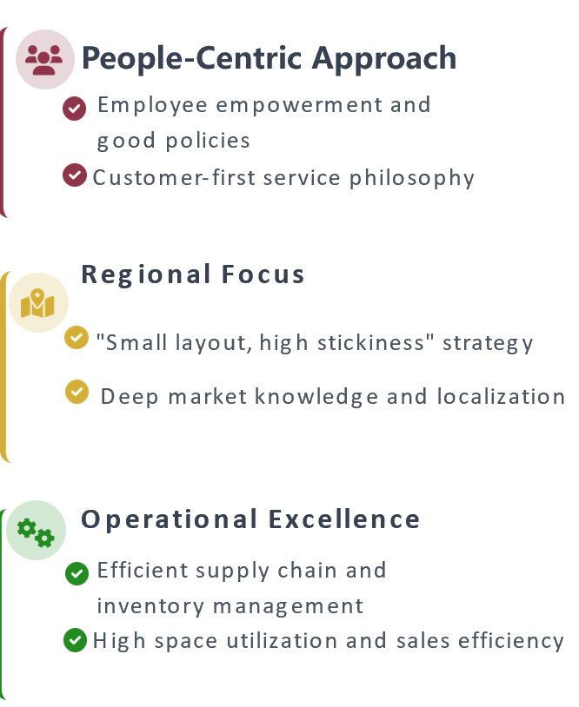
Further Exploration
3.1 Conclusion: Operation
 | Other brands | Profit Contribution | Pangdonglai | Profit Contribution
Front desk profit
Product sales price difference
Service value added
Back-end profit
Admission fee
Promotion fee
Procurement | high |  | low
Market area | Mainland |  | Henan
Turnover rate | Less |  | High
Self-operated products | Less |  | More
Sales channels | Off and online |  | Offline
Introduction
Business Model Analysis
Further Exploration
Summary

Slide 17
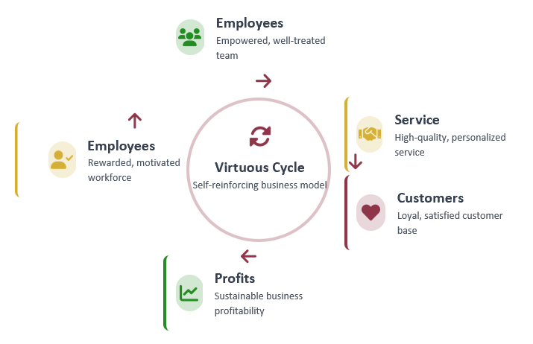
Further Exploration
3.1 Conclusion: Strategic
"Not making money, winning people's hearts"
— This people-first approach creates a self-sustaining cycle that drives long-term success
Introduction
Business Model Analysis
Further Exploration
Summary

Slide 18
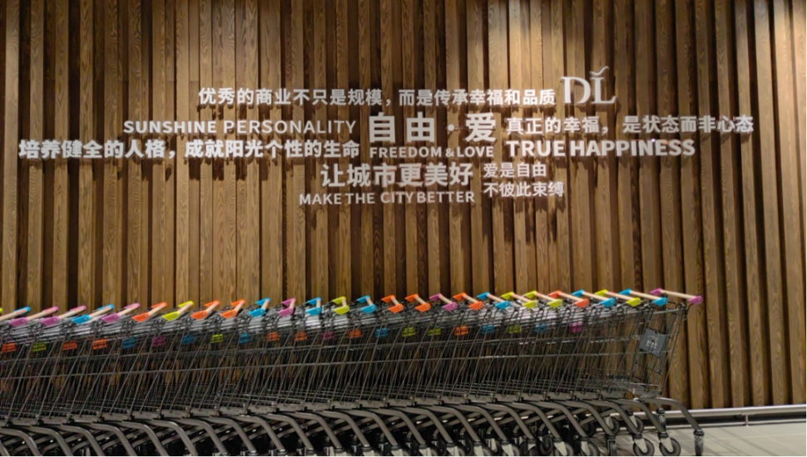
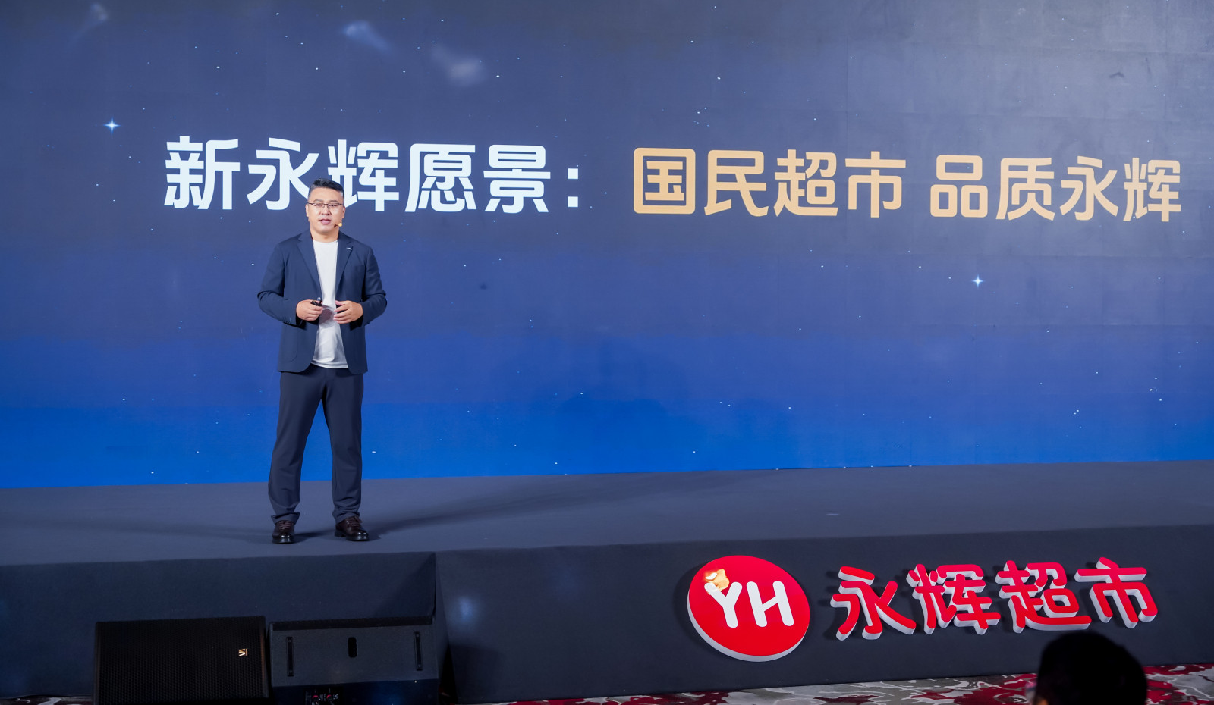
Further Exploration
3.2 Pang Donglai v.s. Yonghui
Core difference between Pang Donglai and Yonghui lies in their business philosophies and models.
Human-centered values, happiness, and experience first
Scale efficiency, fresh produce flow, cost control
Boutique Community Store
Large-scale daily supermarkets
Value differences Business model differentiation
Introduction
Business Model Analysis
Further Exploration
Summary

Slide 19

Further Exploration
3.2 Pang Donglai v.s. Yonghui
Operation Focus
Boutique Community Store
Traditional Hypermarket
Scale
Experience Space
Self-Created Design
Strategies for Residents' Stay Time
Comprehensive Product Range
Efficiency, and Coverage
Core difference between Pang Donglai and Yonghui lies in their business philosophies and models.
1
Operation Focus
Introduction
Business Model Analysis
Further Exploration
Summary

Slide 20
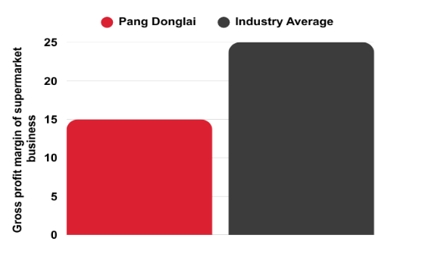

Further Exploration
3.2 Pang Donglai v.s. Yonghui
Core difference between Pang Donglai and Yonghui lies in their business philosophies and models.
2
Profit Model
Pang Donglai
Yong Hui
Unit value density
Relying on standard product entry fees and rebates
High turnover efficiency
1.2 Days
entry fees
Low‐value, scale driven
Experience premiums
78 RMB
Overall profitability under pressure
Introduction
Business Model Analysis
Further Exploration
Summary

Slide 21

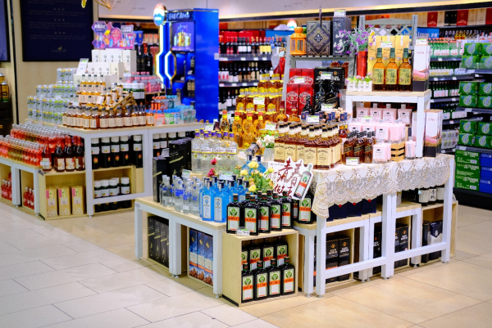
Further Exploration
3.2 Pang Donglai v.s. Yonghui
Core difference between Pang Donglai and Yonghui lies in their business philosophies and models.
3
Product Strategy
4
Culture and Management
    High self-sourcing ratio (approximately 80%)
    Strong pricing power
    Meticulous product selection
    Transparent quality control
Service-driven
Training-empowered
Happiness management
    High proportion of fresh produce sourced directly
    Low proportion of private label products (approximately 5%)
    Covers all daily necessities.
Organizational systems and costs
Shifting from "institutional efficiency" to "experience efficiency"
Introduction
Business Model Analysis
Further Exploration
Summary

Slide 22
Further Exploration
3.2 Pang Donglai v.s. Yonghui
Yonghui's potential for upgrading lies not in "becoming like Pang Donglai," but in addressing its shortcomings in culture and customer experience.
1
Improve user experience
2
From system management to service-driven
Creating community spaces and extending dwell time
Upgrade shopping into an experience
Improve frontline staff compensation and incentives
Establish a training system and service culture
Transform from "substitute labor" to "value touchpoints"
3
Selected supply chain
4
Self-operated and processing capabilities
Control SKUs, rigorously select suppliers
Strengthen supplier screening and oversight transparency
Develop small-scale premium products in specific regions.
Precisely develop fresh food/processed food/own brands
Build trust premium through quality
Introduction
Business Model Analysis
Further Exploration
Summary

Slide 23
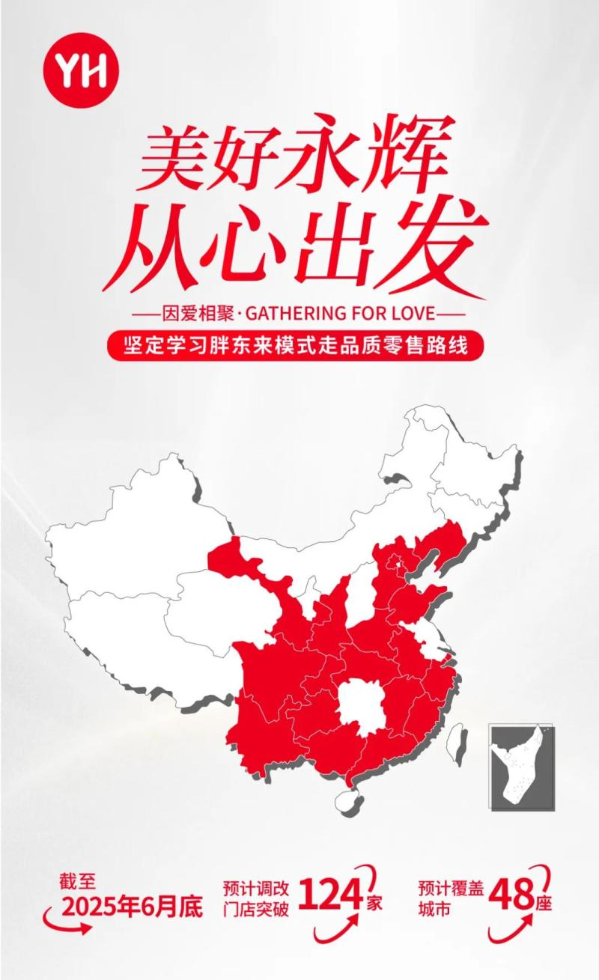
Further Exploration
3.2 Pang Donglai v.s. Yonghui
Yonghui cannot become Pang Donglai, but it can become more like a "trial version of Yonghui".
Regional coverage and channel capabilities
Yonghui has many stores, is close to communities, covers a wide audience, and has a stable customer base.
Digital infrastructure
Yonghui has paid memberships, online mini-programs, and a digitalized fresh food supply chain, while Pang Donglai focuses on offline manual processes.
Fresh produce serves as a core competitive entry point
Yonghui can attract essential consumer traffic by "replacing traditional wet markets," meeting the daily needs of residents of all ages.
Introduction
Business Model Analysis
Further Exploration
Summary

Slide 24
Further Exploration
3.3 Progress and Effects of Transformation
Overall Progress
Performance of Benchmark Stores
2025Q3 Complete 222 Stores → Scale effect
Guangzhou Liying Plaza Store (Urban Flagship Representative)
Location: Downtown business district & transportation hub
Focus: High-quality consumption needs
Starting Time: May 2024
Location: First-tier cities (Bei, Shang, Guang, Shen) and core business districts of new first-tier cities (Chengdu, Wuhan etc.)
Fuzhou Fuxin Store (Community Standalone Store Benchmark)
Focus: Community consumption
Performance: Profitability and month-on-month growth
Cumulative performance: 63 million yuan
Current Phase
Shifting: High-quality horizontal transformation →
in-depth upgrading
Focus: Health
Tianjin SM Binhai Plaza Store (Commercial Complex Store)
Dividends: Cumulative dividends 2.6 million yuan
Cumulative sales: >350 million yuan
Introduction
Business Model Analysis
Further Exploration
Summary

Slide 25
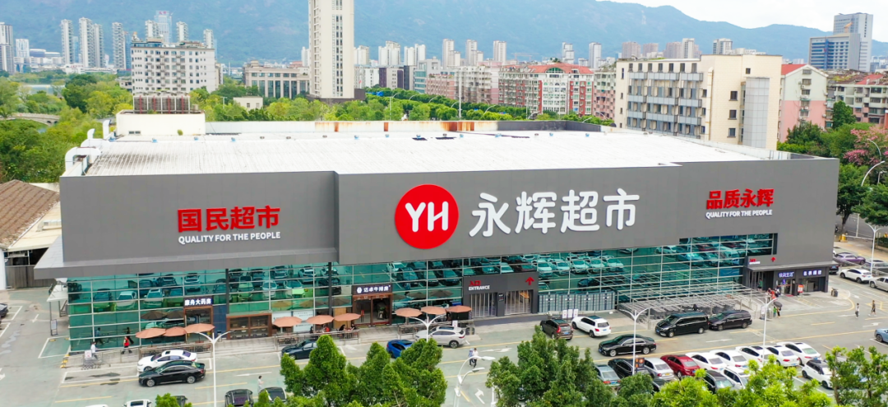
Further Exploration
3.3 Strategy & Supply Chain Reform
Core Strategy: Product-Centricity
Continuously advance supply chain reform to develop quality retail
The first batch of flagship products gaining market validation
Reform effects have emerged, entering a new stage of positive circulation
Supply Chain Reform
Product-Centric Transformation
Measures:
a. Promote naked-price direct sourcing
b. Cancel traditional channel costs
Effect: Impact the profit structure in the short term but value-proven in the long-term
Target:
Lock in 200 core strategic partners
Create 100 100-million-yuan flagship products
Progress: 2 series ("Yonghui Custom" and "Quality Yonghui”)
Performance: Total cumulative sales over 100 million yuan
Introduction
Business Model Analysis
Further Exploration
Summary

Slide 26
Further Exploration
3.3 Financial Performance after Transformation
Key Financial Data (2024-2025)
Period | Operating Revenue (100 million yuan) | Net Profit Attributable to Shareholders of Listed Company (100 million yuan) | Net Profit after Deduction of Non-recurring Gains and Losses (100 million yuan) | Net Cash Flow from Operating Activities (100 million yuan)
2024Q1 | 216.65 | 7.36 | 5.99 | 19.84
2024Q2 | 161.14 | -4.61 | -5.69 | 9.55
2024Q3 | 167.70 | -3.53 | -6.92 | 8.36
2024Q4 | 130.25 | -13.88 | -17.49 | -15.84
2025Q1 | 174.79 | 1.48 | 1.37 | 5.72
2025Q2 | 124.69 | -3.88 | -9.40 | 6.35
2025Q3 | 124.86 | -4.69 | -7.00 | \
Introduction
Business Model Analysis
Further Exploration
Summary

Slide 27
Further Exploration
3.3 Financial Performance after Transformation
Key Financial Performance Analysis(2024-2025)
Operating Revenue Trend:
Sustained Decline with Narrowing Quarterly Fluctuations
Performance: The year-on-year decline widened from 2024 to 2025; Quarterly sequential fluctuations narrowed from 2024 to 2025Q3.
Reasons:
The transformation result in a phased decline in revenue
Intensified competition in the retail industry
Weak consumer demand leading to a dual decline in the average transaction value and customer flow
Introduction
Business Model Analysis
Further Exploration
Summary

Slide 28
Further Exploration
3.3 Financial Performance after Transformation
Key Financial Performance Analysis(2024-2025)
Net Profit Trend: From profit to sustained loss, deteriorating profitability of core business
Profit Stability: there were 5 quarters of losses, with the fluctuation range of losses increasing
Reasons:
Declining revenue coupled with additional expenses for transformation impact the profit
Seasonal and festival effect in Q1 of each year
Having "one-time gains" (such as asset disposal)
Introduction
Business Model Analysis
Further Exploration
Summary

Slide 29
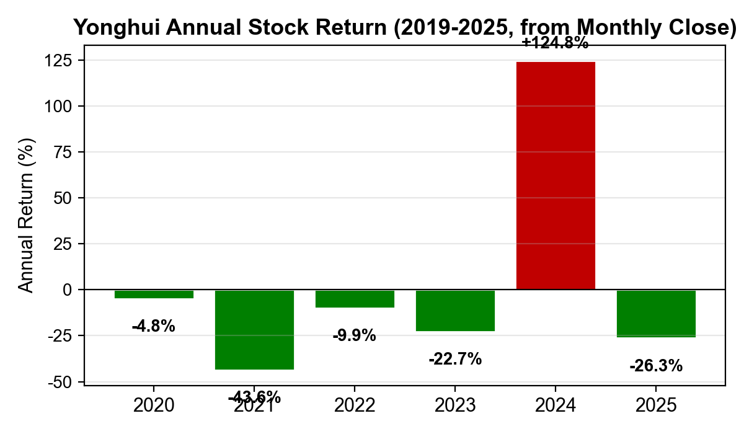
3.3 Market Validation: Stock Price Reaction to the Transformation
Event | Date | [-1,+7]
Pangdonglai-style turnaround announced | 2024-05-31 | +6.7%
First remodeled store opened | 2024-06-19 | -7.1%
Miniso 29.4% stake offer | 2024-09-23 | +61.3%
The market had already priced in the failure of the scale model: the stock fell 43.6% in 2021 when Yonghui first turned loss-making. 2024 marked a turning point: full-year return was +124.8%. The May 2024 Pangdonglai-style turnaround announcement generated a [-1,+7] return of +6.7%, while the September 2024 Miniso 6.27bn takeover offer triggered a +61.3% event window. Capital markets validate the quality-transformation narrative.

Slide 30

Further Exploration
3.3 Future Development and Recommendations
Current status
The cumulative same-store sales in the first three quarters of 2025 have returned to positive growth, indicating its core business is improving steadily.
Core Recommendations
Renovate 450 stores
Incentivize staff and upgrade services
Integrate online-offline channels and use digital tools to reduce costs
Manage capital efficiently
Rebuild brand image around "quality“
Future Development
Yonghui is adopting the Pang Donglai model, pursuing a quality-focused retail strategy and build a "New Yonghui" model that meets market expectations
Introduction
Business Model Analysis
Further Exploration
Summary

Slide 31
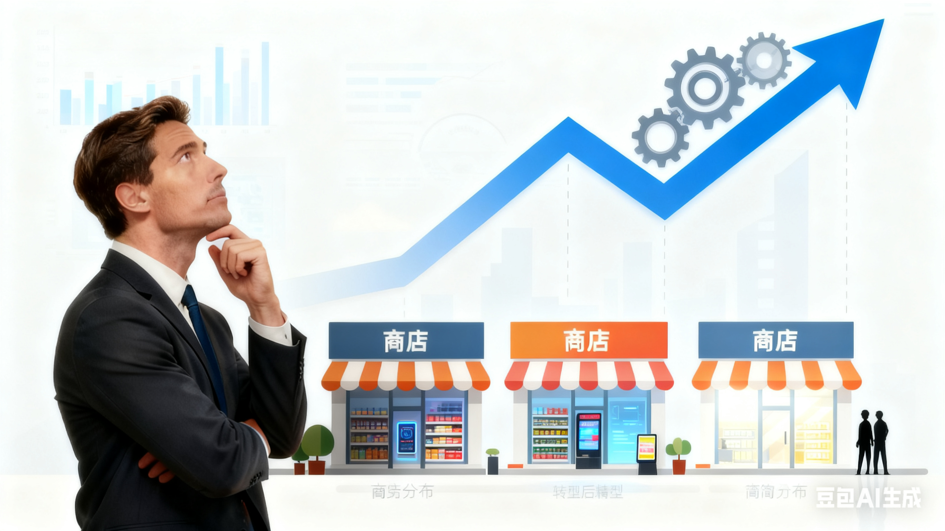
Summary
4.1 Summaries
Spot the issue
Conduct Analysis
Suggested Strategies
Reveal financial failure in Yonghui & the downward trend of the retail industry
Data collection & Methodology
Business Model Analysis: profitability collapse, profit decomposition, revenue decomposition
Ratio & Trending Analysis: revenue vs. net profit margin, profit structure breakdown, operating expense ratio, regional revenue concentration & margins
Learn from Pang Dong Lai – Winning people’s heart: Improve user experience, from system management to service-driven, selected supply chain, self-operated and processing capabilities
Core Strategy: Product-Centricity, Supply Chain Reform
Introduction
Business Model Analysis
Further Exploration
Summary

Slide 32
Thanks for listening!

